Slide 1
Computer Graphics
Drawing

Slide 2
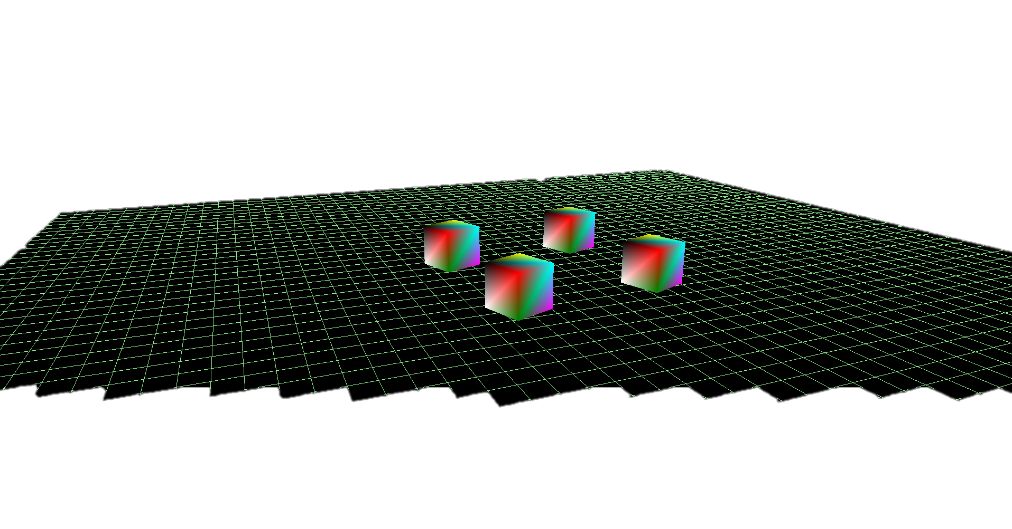
Drawing - Up to this point
Now that our application is up and running, we need to create the structures which we will use to pack vertices, indices, their buffers and more, in order to represent objects. We will explain these through the implementation of its elements.
We will start by defining what will be draw on each frame, the basic drawing units, the steps and resources we will need for the pipeline to process all the vertices and techniques we can use to optimize what we have built so far.

Slide 3
Drawing - How does it work ?
In general, a Draw() call will render a single frame. It will be called by our application, from its main loop, N times a second (Frames Per Second), usually 60-30.
The general tasks of Draw() are:
Check the fence status (until which command set the GPU is done processing).
Reset the commands lists and allocators.
Set the view port and scissor rectangle
For the current back buffer (to be drawn on), set the proper state, and clear it.
Clear the depth buffer
Set the buffer as the render target
Update the camera’s view project matrices and frame data (matrices we will use often for each frame)
Send commands for drawing all the objects we want
Close and execute the command list
Update the fence

Slide 4
Drawing - What will we Draw?
Let us define the drawing unit. For this, two questions: What will we draw? and how will we group them?
Let us create an abstract representation of an entity (object) and everything that’s associated with it:
Entity
Name (Cube, Sphere, Triangle, Camera, World Parent, anything)
Vertices (Array of Vertex struct)
Constant Buffer (Buffer with the Entity’s world matrix)
Vertices Topology
Indices
Upload Buffer (CPU updatable on demand)
Orientation Matrix (Matrix (right, up, forward, position) )
Children Entities (Nested entities)
State variables (IsDynamic, IsEnabled, IsDirty …)
Transform() (Translate, Rotate, Scale)
This summarizes the basic components we will need to know for each simple object we would like to draw on the scree.
When Draw() is called, will check:
For each dirty object
(logic updated its vertices)
Update its buffers (Upload and constant)
Send it to the pipeline binding the proper descriptors.

Slide 5
Drawing - What will we Draw? - Binding the Buffers to the Pipeline
Each entity will have at least 3 buffers: one for vertices, one for indices and a last one for its model matrix (world orientation matrix)
5
6
For example:
Vertex Buffer: 8 vertices
Index Buffer: 36 indices
Using index buffers will save us a LOT of room in memory, instead of using 36 vertices from which many will be repeated.
Each side of the cube is made out of 2 triangles. There are 6 sides, of 2 triangles each, which are made out of 3 vertices per triangle = 36 indices.
Example front: (0,1,2) - (0,2,3)
1
2
4
7
0
3
(-1,-1,-1)

Slide 6
Drawing - What will we Draw? – Dynamic Buffers
In any given scene, we will most likely have two types of elements:
Static elements
Dynamic entities
For starters, out implementation can heavily benefit from using the same design for all of our entities, this is, same buffers, data and more. We need to add a flag, IsDynamic, which will send the vertices to the pipeline, but save cycles on updating its buffers.
For dynamic entities, the updating process is really straight forward:
On Create
→ The entity will initialize buffers and put their GPU address in the Descriptor View.
On Update
→ We simply change the values of the vertices array of the entity
→ Copy this array (stream of bytes) to the entities vertex buffer

Slide 7
Drawing - What will we Draw? - Binding the Buffers to the Pipeline
Once we updated the vertices, we need to bind the buffer to the pipeline during Draw(), using a descriptor just as we did for the swap chain and depth/stencil buffers.
Once we bind a buffer, it will remain bound until the pipeline is done processing, it cannot be change, nor the allocator reseted.
Buffers are ID3D12Resource byte-streams. The only difference between them is the type of data we will upload to them when needed, usually when the application’s logica changes the vertices or other data. This buffers are mapped to CPU-writable memeory locations and after updated, this will be ready to be drawn in the next call.
Wecould use individual buffers for each object (more dynamic), or we could merge them all in a continuous one to optimize a bit the GPU’s rendering process by reducing a potential context-switch overhead. We must be careful to always compute the offset correctly.
GeoVB₁
GeoVB₂
GeoVB₃
k = sizeInd(Geo₁)
j = k + sizeInd(Geo₂)
0
k
j
GeoIndex₁
GeoIndex₂
GeoIndex₃

Slide 8
Drawing - What will we Draw? - Binding the Buffers to the Pipeline
We will use the more dynamic approach, for this, allows us to create, modify and draw objects independently from each other.
So, to summarize, each Entity will:
Keep its own upload and constant buffer
Have references to their own descriptors
Pass their descriptors to the Root Signature on every call.
With this approach, we could have k number of objects without worrying about recreating, copying or resizing buffers and offsets. For now, it will work. How can we group these?

Slide 9
Drawing - How will we group them?
So we have a set of objects, represented as entities, which, during a Draw() call, on each frame, can have their buffers sent into the pipeline. Ok, what if we need other resources, such as textures or something which also need to go with one or more entities but are NOT part of the definition of an entity? Furthermore, how can we make sure we are not disturbing other buffers etc… during Draw() ‘s setup?
For ALL the resources (entities, textures, etc…) we will need for a single draw, we will group them in a class which might carry more information.
This class will have two critical parts:
Additional buffers (added on demand, as needed for resources)
A Fence controller ← This will result in a critical optimization of the application.
Let’s take a look at the actual logic for Draw() using this model…

Slide 10
Drawing - Draw() using a global Fence per call
For small tasks, we do not necessarily need to kill ourselves with optimizations, so intuitively, we could:
1) Set up frame
2) Push all entities into the pipeline
3) Close and execute the command list
4) Flush the GPU queue – Stall the CPU until the GPU signals it reached the necessary Fence
This is not terribly bad for small setups, but let’s see what’s happening:
Fence
0
1
2
Too many cycles wasted waiting for the GPU, we want to keep it busy. Stalling the CPU is OK, we need that for logic processing.
CPU
idle
idle
GPU
idle
idle

Slide 11
Drawing - Draw() using multiple Fences
We could do a small tweak in order to optimize the use of the GPU. This is, letting each FrameResource to keep track of its own Fence. The CPU will keep sending geometries into the pipeline until the GPU needs to catch up with the CPU, making the process more linear for both the GPU and CPU.
Fence
0
1
2
The CPU will not Flush the GPU’s queue after each iteration of Draw(), but instead, will keep submitting until the GPU needs to catch up for the next buffer.
CPU
GPU
So, because for each Draw() call, we will use a single FrameResource command allocator, we can say that the fence of each FrameResource is
fr.Fence = max(lastCompletedFence+1, fr.Fence)

Slide 12
Drawing - Draw() using multiple Fences and FrameResources
Below you can see pseudo code for a Draw call using the current FrameResource Fence value:
Draw()
FrameResource r ← frameResources[++current]
current++
checkFence(r.Fence) // if r.Fence > lastFenceCompleted: STALL! (FlushGPUCommandQueue)
r.Fence = ++lastFenceCompleted;
Command allocator ← r.Allocator()
Reset commandList(allocator)
Setup global frame // Render target, camera and frame resources
// assuming each FrameResource holds 1 entity, we will update them all
for each FrameResource fr in frameResources
fr.Update() // Updates all the buffers of its resources
Bind descriptors
Draw Entity // send to the pipeline – here we call the actual drawing command
end loop
Close command list and send to GPU’s queue
GPUqueue.signal.setFence(fr.Fence)
End

Slide 13
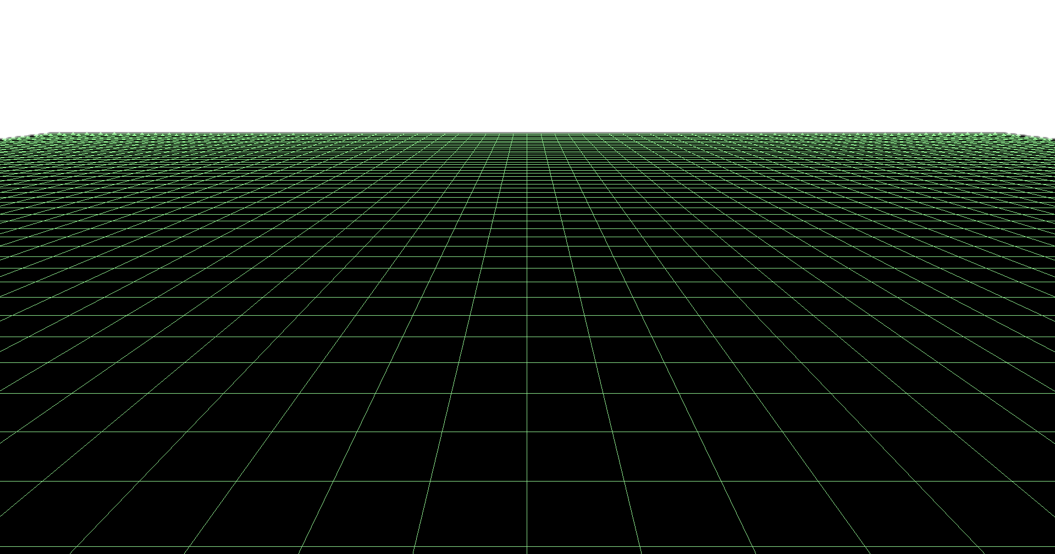
Drawing - Geometries - Grid
Polygons
Let us define some basic geometries for our implementation: a Grid, a Cube and a Cylinder. Each Polygon will extend Entity and potentially override its virtual methods.
Grid
This are very useful as visual guides for general debugging and development. A static Grid is centered at (0,0,0) and its squares sides are of unit size.
The way we generate the vertices of a Grid(N squares) is the following:
For each row z ← starting from bottom left-most vertex
For each Column x from left to right
// add vertex
vertices.add(new Vertex(xValue,0,zValue)
// add index
add immediate vertex index
add next row’s equivalent column vertex

Slide 14
Drawing – Geometries - Cube
Cube
As mentioned, we will only need 8 vertices and 6 faces * 6 vertices = 36 indices
5
6
(1,1,1)
(-1,1,-1)
// front face
0, 1, 2,
0, 2, 3,
// back face
4, 6, 5,
4, 7, 6,
// left face
4, 5, 1,
4, 1, 0,
// right face
3, 2, 6,
3, 6, 7,
// top face
1, 5, 6,
1, 6, 2,
// bottom face
4, 0, 3,
4, 3, 7
1
2
4
7
0
3
(-1,-1,-1)

Slide 15
Drawing – Geometries - Cylinder
Cube
The cylinder is a bit more parameterized and adjustable, based on certain values:
tR = top radius sH = stack height
bR = bottom radius tH = total height
s = number of stacks
sl = number of slices Some values can be obviously derived.
With tR <= bR, then, for the i^{th} stack, we calculate its y value and radius:
// we start at the bottom on y
stackHeight = -1/2*h + i*sH
stackRadius = bR – i * (bR - tR)
We will have roughly (stacks*2 +3)*3*slices indices

Slide 16
Drawing – Geometries - Cylinder - Example
14
13
12
Indices for two stacks (example)
Bottom face (just first set)
(1,8,0) ← Bottom face triangle, order matters
(0,910) ← Current, Up, Diagonal Forward
(0,10,1) ← Current, Diagonal Up, Next
This results in:
14
16
11
15
10
9
10
9
5
4
3
6
2
8
8
1
7
1
0
0

Slide 17
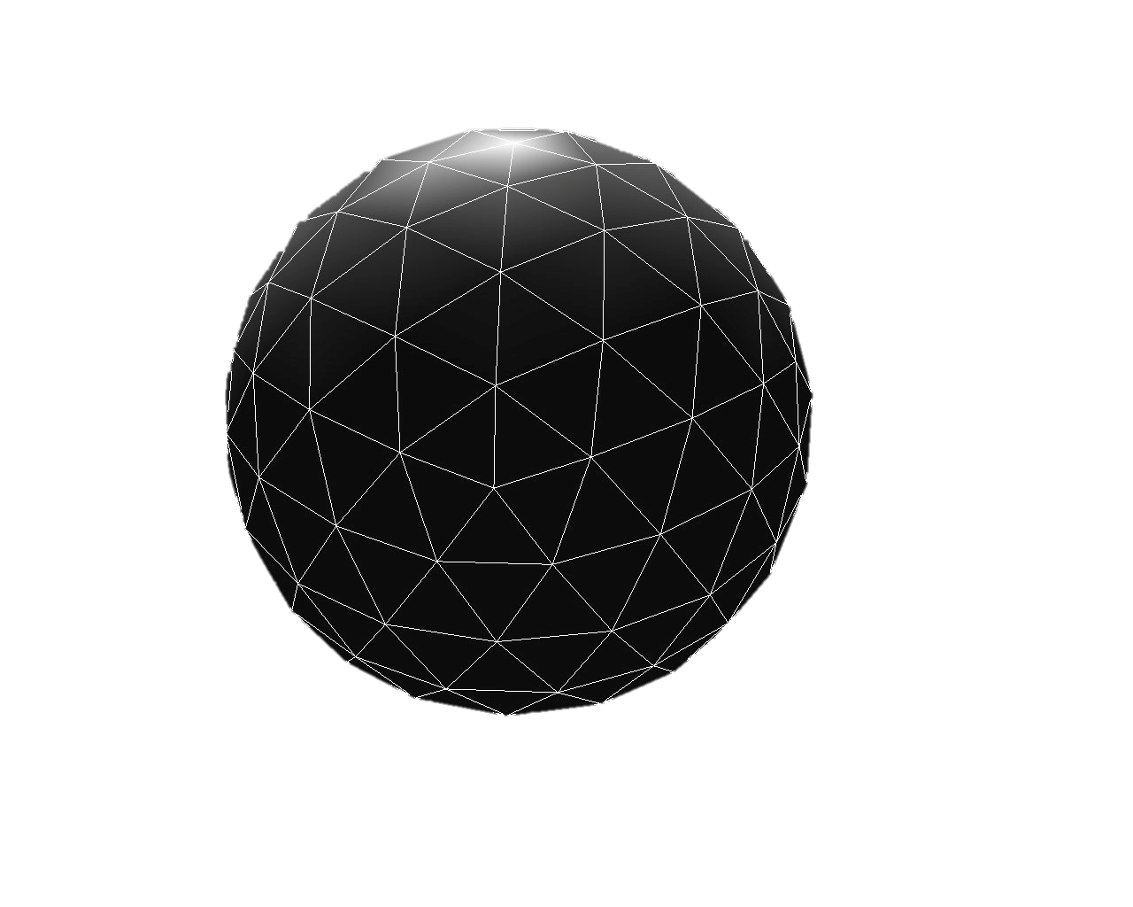
Drawing – Geometries - Sphere
These are a bit trickier than other polygons, for these, will derived from the continuous subdivision of triangles within triangles, based on a specified level of detail.
We start with a icosahedron (20 faces polygon) and then we triangulate it N number of times. Each original triangle is subdivided in 4 new ones, hence each time we triangulate, we increase the number of vertices by 2, 3 for the original triangle, 3 for the new ones.
IMPORTANT
Note how all the resulting triangles have the same area!

Slide 18
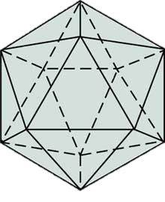
Drawing – Geometries - Sphere - Icosahedron
Top
L
We will start with forming a icosahedron with 20 equals area sides. We need to determine the length of the side of each triangle, and derive its height from it. Let the height be length of the side be s, then the its height is
s² – ((1/2)*s)² = h
The total height from end to end of the polygon will be 1 ½ * S = L the height of the triangles
Let C be the “top” vertex of the polygon at (0, ¾ * L, 0)
From C, we will start drawing a same-length size pentagon, with its first vertex at rotate((0,C,S), 30deg), then we rotate 72 degrees from C for the next 4.
Mirror the pentagon at (0, ½*L, 0) with all its vertices (x’,y’,z’) to be (x,-y,-z) from the original (mirrored)
Triangulate the top-bottom vertices
L
C
30 deg
C
30 deg slope
(x,y,z)
s
L
(x’,y’,z’)

Slide 19
Drawing – Geometries – Sphere - Triangulation
As stated before, now we will triangulate each of the 20 original sides k times.
For each triangle in the original polygon, we will obtain 4 new ones, such that if we originally have 5 triangles, with 15 indices, we will end up having roughly (5*3*4) on each iteration.
Lets start by determining a minimum number of triangulations, let k = 4.
So the logic for triangulating k times is simple:
Polygon p;
for(int i = 0; i < k; ++i) {
p = triangulate(p)
}
We will see how can we triangulate the icosahedron.

Slide 20
Drawing – Geometries – Sphere - Triangulation
Triangulate Top and Bottom Pentagons
We will use a practical approach for triangulating, rather than to triangulate the inside triangles, we will add triangulated layers until we formed the proper number of tringles, example:
Original Icosahedron top
Given a pentagon, what parameter do we need?
How many vertices we have: V
How many indices we have: In
How many triangles we have: T = In/3
How many triangles we will create: T’ = T * 4
For which we need indices: In’ = T’ * 3
Finally, and most importantly, we need to know how may vertices we need to create, because the new ones will overlap with the previous layers ones, we will be introducing 5*(i) on each layer where i is the iteration number. This yields to:
T/2 + 5*(floor(log₅In’))
After the first triangulation

Slide 21
Drawing – Geometries – Sphere - Triangulation
As an example, consider the following table:
We subtract C, common to all iterations (the center vertex) – also, i might not be know, just the given polygon.
Iteration (i) | Vertices (v) | Triangles (t) | Indices (In)
0 | 5 (minus C) | 5 | 15
1 | 15 | 20 | 60
2 | 50 | 80 | 240
3 | 180 | 320 | 960
Note the relationships, assume 1 <= i
i = (floor(log₅In))
T_{i} = 4 * T_{i-1}
v_{i} = T/2 + 5 * i
In_{i} = 4 * In_{i-1}
In summary, we need to know:
How many vertices we will add, note we need In , not In’
How many Indices
Initial angle for adding the vertices = 72 / i then, we increase i as we accumulate 360 degrees each time.

Slide 22
Drawing – Geometries – Sphere - Triangulation
Now that we know how many vertices we need to add and how apart they will be, we need to make sure we place the point in the right (x,z) location, linearly interpolating the current points, to respect the pentagon.:
p₁ @ 90 deg
By keeping track of the sumAngle per round, we can determine when we must divide 72 for the next layer, and also, valuable information for the interpolation between p₁ and p₂
Each new vertex will have it’s x on cos(offset-72/i), but not its z, for this would give coordinates for a unit circle, right? so we will get z by interpolating the two known points:
p₁ = floor((72*i) / sumAngle)
p₂ = ceiling((72 * (i+1)) / sumAngle)
so finally:
z = z₁ + ((offset-cos(72/i) – x₁) * (y₁ – y₂) / (x₂ – x₁) → (z,x)
p₂
Note that sumAngle must be mod 360 (or 2 PI) and after every round we increase i by 1

Slide 23
Drawing – Geometries – Sphere - Triangulation
Summarizing the layer approach Pentagon’s triangulation:
Find how many vertices we need to add.
For each vertex, compute the right position by linearly interpolating it’s x position in between points.
Next we will deal with triangulating its sides.

